Slide 1

HTML Parsers
Dima Ionut Daniel

Slide 2
Contents
What is HTML?
Jsoup
Neko HTML
Jtidy
HtmlParser
HtmlCleaner
Conclussion
Bibliography

Slide 3

What is HTML?
HTML (HyperText Markup Language) is the standard markup language used creating web pages.
Web browsers can read HTML files and render them into visible or audible web pages.
HTML elements form the building blocks of all websites.

Slide 4
Jsoup
Jsoup is a Java library for working with real-world HTML.
Jsoup provides a very convenient API for extracting and manipulating data, using the best of DOM,CSS.
Jsoup implements HTML5 specification and parses HTML to the same DOM as modern browsers do.
scrape and parse HTML from a URL, file, String
find and extract data, using DOM traversal or CSS selectors
manipulate the HTML elements, attributes and text
clean user-submitted content against a safe white-list to prevent XSS attacks
output tidy HTML

Slide 5

Jsoup (cont.)
The Jsoup library it’s easy to use.
The Jsoup class can be used to parse HTML content.
The Document class allow DOM,CSS traversal.

Slide 6

Jsoup (cont.)
Jsoup can parse HTML fragements using the parseBodyFragment.
The method creates an empty shell document and inserts the parsed HTML into the body element.
Document.body() method it’s equivalent to doc.getElementsByTag(„body”);

Slide 7
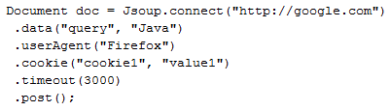
Jsoup (cont.)
Jsoup can fetch and parse HTML document using the connect method.
The connect() method created a new Connection object and get() fetches and parses a HTML file.
If an errors occurs then it will throw an IOException.
The Connection interface can be used to send POST requets also.

Slide 8
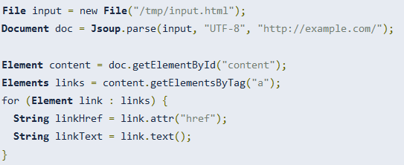
Jsoup (cont.)
After the HTML document is parsed we can extract certain information.
Finding elements:
getElementById(String id)
getElementsByTag(String tag)
getElementsByClass(String className)
getElementsByAttribute(String key)
parent()
children()
child(int index)

Slide 9
Jsoup (cont.)
Element data:
attr(String key)
attributes()
id(), className(), classNames()
text() → gets text content
text(String value) → sets text content
html() → get HTML content
html(String value) → sets inner HTML content
outerHtml() → gets outer HTML value
data() → data content (script, style tags)
tag(), tagName()

Slide 10
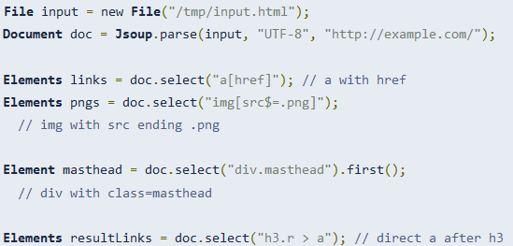
Jsoup (cont.)
Jsoup can find and manipulate elements using CSS or jquery-like selector syntax.
The select() method is available in a Document, Element or in Elements.
We can filter by selecting from a specific element or by chaining select calls.
Select returns a list of Elements, which provides a range of methods to extract and manipulate the results.

Slide 11
Neko HTML
NekoHTML is a simple HTML parser using the standard XML interfaces.
NektoHTML is written using the Xerces Native Interface(XNI) that is the foundation od the Xerces2 implementation.
In oder to parse HTML content the DOMParser.parse method is used.
The parse method returns a org.w3c.dom.Document elements that contains the HTML elements.

Slide 12
Jtidy
Jtidy is a Java port of HTML Tidy, HTML syntax checker and pretty printer.
Jtidy provides a DOM interface to the document that is being processed.
Jtidy can be used as a tool for cleaning up malformed and faulty HTML.
The entry point for accessing Jtidy functionalities is the org.w3c.tidy.Tidy class.
The parse method is used to parse the HTML content.

Slide 13
HtmlParser
HTML Parser is a Java library used to parse HTML.
The parser is designed to work as a drop-in replacement for the XML parser.
Supported XML APIs are: SAX, DOM.
Also streaming SAX and buffered SAX are supported.

Slide 14
HtmlCleaner
HtmlCleaner is an open source HTML parser.
HtmlCLeaner reorders individual elements and produces well-formatted XML.
In order to start we need to use the clean() method from org.htmlcleaner.HtmlCleaner class.

Slide 15
Conclussion
Almost all known HTML parsers implements the W3C DOM API.
Jsoup also provides a completely own API.It gives you the possibility to select elements using jQuery-like CSS selectors and provides an API to traverse the HTML DOM tree.

Slide 16

Bibliography
https://en.wikipedia.org/wiki/HTML
http://jsoup.org/
http://nekohtml.sourceforge.net/
http://jtidy.sourceforge.net/
http://htmlcleaner.sourceforge.net/
https://about.validator.nu/htmlparser/

Slide 17
Questions ?

